Slide 1
For Live Session
Unit 11: Time series analysis
Carlos Estevez

Slide 2
Activity One: SES (1 hour)
install.packages("fpp")
library(fpp)
# 1. SES MODEL FOR AUS AIR
data(ausair)
#returns a ts object
air = window(ausair, start = 1990, end = 2004)
# Always plot the data first!
plot(air,ylab = "Airline Passegners", xlab = "Year", main = "Airline Passengers")
#fit 3 different simple exponential smoothing models ... how are they different?
# what does the h paramter do?
fit1 = ses(air, initial = "simple",alpha = .2,h = 3)
fit2 = ses(air,initial = "simple",alpha = .6, h = 3)
fit3 = ses(air, h = 3) #defaults
# the forecast package has a nice accuracy funciton with various metrics just pass it the
# the model and the data! (This is the "training" data)
accuracy(fit1, ausair)
accuracy(fit2, ausair)
accuracy(fit3, ausair)
#Reset the plot
plot(air,ylab = "Airline Passegners", xlab = "Year", type = "o", xlim = c(1990, 2008),ylim = c(15,50), main = "Airline Passengers")
#Plot the estimated values from the models .. the "fitted" values are the training values.
lines(fitted(fit1), col = "blue", type = "o")
lines(fitted(fit2), col = "red", type = "o")
lines(fitted(fit3), col = "green", type = "o")
# the $mean values are the forecasts.
lines(fit1$mean, col = "blue", type = "o")
lines(fit2$mean, col = "red", type = "o")
lines(fit3$mean, col = "green", type = "o")
# These are the actual values! Compare visually with the forecasts!
air2008 = window(ausair, start = 1990, end = 2007)
points(air2008, type = "o")
# Compare the forecasts with the actual values with various fit metrics.
accuracy(fit1, air2008)
accuracy(fit2, air2008)
accuracy(fit3, air2008)
Run this code and get a feel for what it is doing. Feel free to change it up and just learn by playing. Create a slide that allows you to discuss the output / analysis / result.

Slide 3
Activity Two: Holt Linear (1 hour)
#2 Holt's Linear Trend Model for AUS AIR
fit1h = holt(air, alpha = .8, beta = .2, initial = "simple", h = 5)
fit2h = holt(air, alpha = .8, beta = .2, initial = "simple", exponential = TRUE, h = 5)
# Check out estiamted values of the "training" data from the first holt model
fitted(fit1h)
# Check out the forecast value (h of them)
fit1h$mean
# Reset the Plot!
plot(air,ylab = "Airline Passegners", xlab = "Year", type = "o", xlim = c(1990, 2009),ylim = c(15,60))
#Plot each models estimated values of the training data (Do these one by one to see the differences)
lines(fitted(fit1h),col = "blue", type= "o")
lines(fitted(fit2h), col = "red", type= "o")
#Plot each models forecasts (Do these one by one to see the differences)
lines(fit1h$mean, col = "blue", type= "o")
lines(fit2h$mean,col = "red", type= "o")
# Fit another model ... damped!
fit3h = holt(air, alpha = .8, beta = .2, damped = TRUE, initial = "optimal", h = 5)
# Plot the fitted value (estimated from triaining data)
lines(fitted(fit3h), col = "darkgreen", type= "o")
# Plot the forecasts
lines(fit3h$mean,col = "darkgreen", type= "o")
# Fit another model ... what is the difference?
fit4h = holt(air, alpha = .8, beta = .2, damped = TRUE, initial = "optimal", exponential = TRUE, h = 5)
# Plot the fitted value (estimated from triaining data)
lines(fitted(fit4h), col = "cyan", type= "o")
#Plot the forecasts
lines(fit4h$mean,col = "cyan", type= "o")
# with implicit Test set... it figures out by the time which are training and which are test.
accuracy(fit1h, ausair)
accuracy(fit2h, ausair)
accuracy(fit3h, ausair)
#with explicit Test set ... (same output)
airTest = window(ausair, start = 2005)
accuracy(fit1h, airTest)
accuracy(fit2h, airTest)
accuracy(fit3h, airTest)
#Add the actual values to visually compare forecasts to actual values
air2008 = window(ausair, start = 1990, end = 2009)
points(air2008, type = "o")
Next, this is similar code with a different model (Holt with linear trend.) Again, run this code and get a feel for what it is doing. Feel free to change it up and just learn by playing. Create a slide that allows you to discuss the output / analysis / result.

Slide 4
Activity Three: Holt Seasonal (1 hour)
#3. Seasonal Trend
#Load the data
data("austourists")
# Read about the dataset!
?austourists
# Always plot the data first!
plot(austourists)
# returns a ts object.
aust = window(austourists,start = 1999, end = 2004)
#fit an additive and multiplicative model
fit1s = hw(aust,seasonal = "additive",h = 40)
fit2s = hw(aust,seasonal = "multiplicative",h = 40)
#Plot the original data
plot(aust,ylab = "Australian Tourists", xlab = "Year", type = "o", xlim = c(1999, 2014),ylim = c(15,60))
#add the fitted values from the model (of the training data)
lines(fitted(fit1s),col = "blue", type= "o")
lines(fitted(fit2s), col = "red", type= "o")
#Now add the forecasts (add these one at a time)
lines(fit1s$mean, col = "blue", type= "o")
lines(fit2s$mean,col = "red", type= "o")
#Compare the accuracy
accuracy(fit1s,austourists)
accuracy(fit2s,austourists)
#add the actual values to visually compare the forecasts to the actual values.
points(austourists, type = "o")
We are changing the data this time. Still just learn by playing with the code and looking closely at the input arguments and the output. Create a slide that allows you to discuss the output / analysis / result. Also, record any questions that pop up while you are playing. We can discuss them in live session.

Slide 5
Activity Four: Full Analysis(3-5 hours)
Temperature Data Using the maxtemp dataset granted by loading the fpp2 package, there are maximum annual temperature data in Celsius. For more information, use help(maxtemp). To see what you’re looking at, execute the command in ‘Examples’ in the help document.
We are only concerned with information after 1990. Please eliminate unwanted information or subset information we don’t care about.
Utilize SES to predict the next five years of maximum temperatures in Melbourne. Plot this information, including the prior data, the SES predictions and the forecast. Add the predicted value line across 1990-present as a separate line, preferably blue. So, to review, you should have the data, the predicted value line overlaying it, and a forecast through 2021, all on one plot. Find the AICc and BIC of this fitted model. You will use that information later.
Now use a damped Holt’s linear trend to also predict out five years. Make sure initial=“optimal.” As above, create a similar plot to the one you just completed for the SES model, but use the Holt fit instead.
Compare the AICc and BIC of the ses() and holt() models. Which model is better here?
Calculate and compare the RMSE from the ses() and holt() models. Which one performs better with respect to this metric?

Slide 6
Bonus: The Wands Chooses the Wizard
Fun with a great plotting function / package… Dygraphs!
Utilize the dygraphs library. Read in both Unit12TimeSeries_Ollivander and _Gregorovitch.csv as two different data frames. They do not have headers, so make sure you account for that. This is a time series of Wands sold over years.
You don’t have your information in the proper format! In both data sets, you’ll need to first convert the date-like variable to an actual Date class.
Use the library xts (and the xts() function in it) to make each data frame an xts object (effectively, a time series). You’ll want to order.by the Date variable.
Bind the two xts objects together and create a dygraph from it. Utilize the help() index if you’re stuck.
Give an effective title and x/y axes.
Label each Series (via dySeries) to be the appropriate wand-maker. So, one line should create a label for Ollivander and the other for Gregorovitch.
Stack this graph and modify the two lines to be different colors (and not the default ones!) Any colors are fine, but make sure they’re visible and that Ollivander is a different color than Gregorovitch.
Activate a range selector and make it big enough to view.
Use dyShading to illuminate approximately when Voldemort was revived and at-large: between 1995 to 1999.
Enable Highlighting on the graph, so mousing over a line bolds it.

Slide 7
ANSWERS

Slide 8
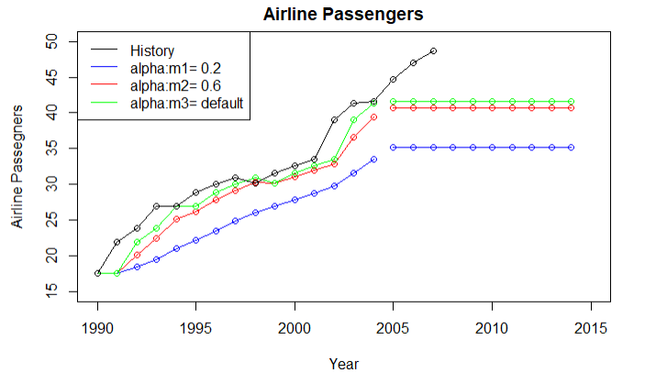
Activity One: SES
Summary
In this exercise we have three SES models that have been set up with different parameters:
M1→Alpha = 0.2(Blue)
M2→Alpha = 0.6(Red)
M3→Alpha = Default(Green), When the value is null alpha is estimated, however we can deduce that this value is greater than 0.6 because higher alpha values place more weight on recent observations
The forecast horizon in this example has been set to 10
Analysis
The historical sales data(Black Time Series) has a trending component. Using SES to forecast these observations is not the best option because the model is unable to detect this trending patter. Using this model in a business setting will not make sense
If we want to analyze which model is best we can know this from two different angles:
1-Looking at the Time series
2-Looking the Forecast errors
Taking both elements into account model 3 is the best by far
Model 1:
Model 2:
Model 3:

Slide 9
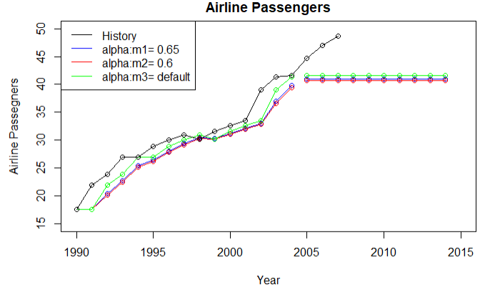
Activity One: SES
Improving model 1
Model 1 is the worst model because is less reactive to the most recent observations. What we will do is trying to improve model 1 by increasing alpha. Remember as alpha increases it will make the model to adapt to the most recent observations
Looking at both plots we can see the significant improvement after increasing alpha from 0.2 to 0.65
The RMSE also got much better
Model 2:
Model 2:

Slide 10
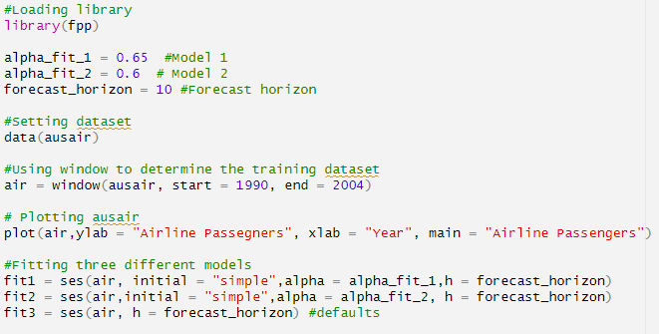
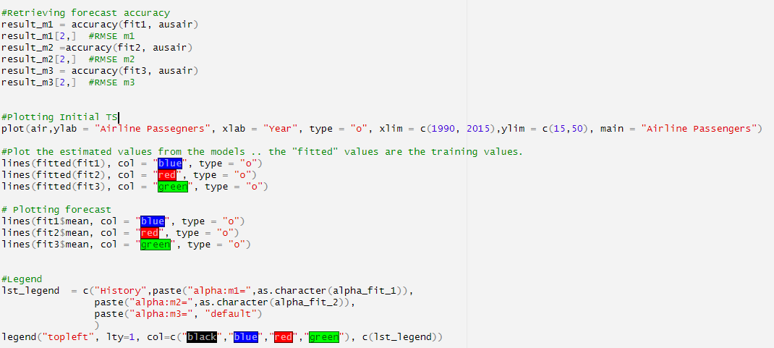
Activity One: SES
Comments source code
Loading library and setting alpha and the forecast horizon
Loading dataset
Using window to subset a TS object(In this way we can define a testing and training dataset using Time Series)
Plotting the first time to analyze the Time Series aiming to find any patterns
Fitting three different models using several alpha values
Calculating forecast errors
Plotting the Historical data and all models
Adding a legend to the plot

Slide 11
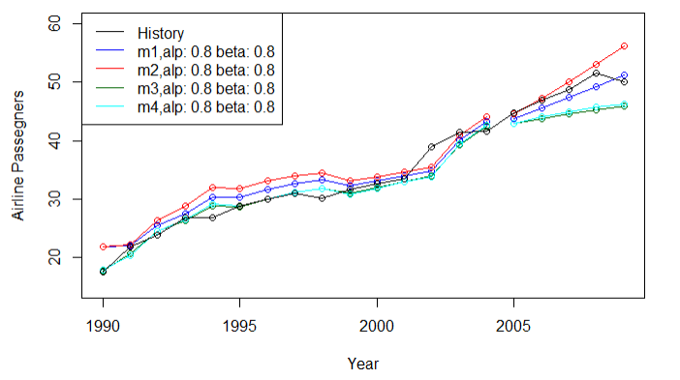
Activity TWO: Holt two parameters(Linear)
Summary
In this exercise we have four different Holt Trending models that have been set up with different parameters
M1→alpha = 0.8, beta=0.2
M2→Multiplicative,alpha = 0.8, beta=0.2
M3→Damped alpha = 0.8, beta = 0.2
M4→Damped multiplicative, alpha =0.8, beta = 0.2
Analysis
The historical sales data(Black Time Series) has a trending component. In the previous exercise we tried to use SES to forecast these observations, however we explained that it was not the best option because the model is unable to detect this trending patter.
Using Holt Two parameters the model is able to detect the trending patter of the time series and give us a better result as we can see in the plot and in the RMSE results
Even the RMSE of the first two models are better I will always pick the Damp Trending model, because a indefinitely constant trend is unlikely. In fact, I’ve had really experience issues in the a few projects when a company opt for using one of these methods for long term forecast and they end up getting over stock. Ultimately I have had to deactivate them.
Empirical evidence indicates that these methods tend to over-forecast, especially for longer forecast horizons. That’s by
I would rather selecting a Damp Trending method like m3 and m4. Even though the overall RMSE is greater than m1 and m2 look what happens with the historical data after ~2008, the trending changes. It seems that there’s a downward trending patter
Model 1:
Model 2:
Model 3:
Model 4:

Slide 12
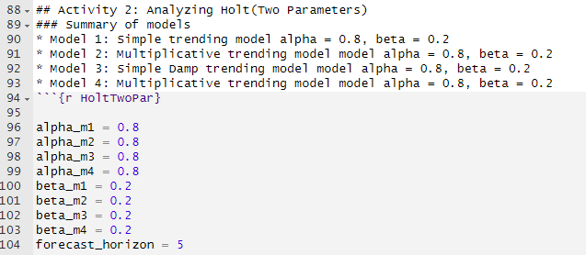
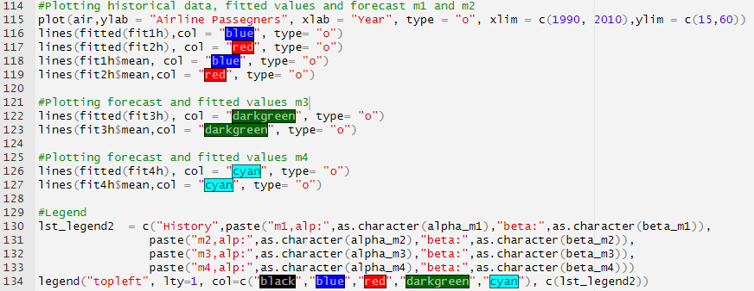
Activity TWO: Holt two parameters(Linear)
Comments source code
Setting the parameters for the model( Alpha, Beta and Forecast horizon)
Fitting four models,
Exponential=”Multiplicative”
Damped=TRUE
Plotting historical data, fitted data and forecast
Creating a legend

Slide 13
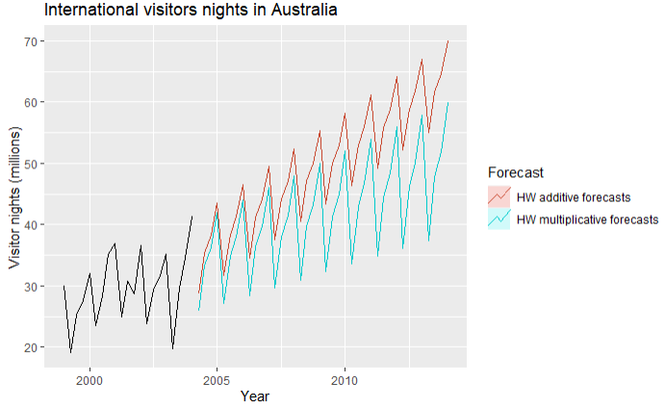
Activity Three: Holt-winters(Three parameters)
Comments source code
In this exercise we are plotting a dataset about the number of visitors nights in Australia
Right away we can notice that there’s a seasonal component in the historical time series data
We used Holt-winter three parameters(Level component, Trending component and seasonal component)
There are two variations to this method:
The additive method is preferred when the seasonal variations are roughly constant
the multiplicative method is preferred when the seasonal variations are changing proportional to the level of the series
We used the function hw. This function can estimate the initial parameters by minimizing RMSE
As we can see from the plot and the RMSE results the multiplicative model develops much better
As it is stated in the definition when the seasonal variations are changing proportional to the level of the series the multiplicative method tends to be better
Another way I used to determine which method to use is by decomposing the time series. Let’s look the next slide
Model 1:
Model 2:

Slide 14
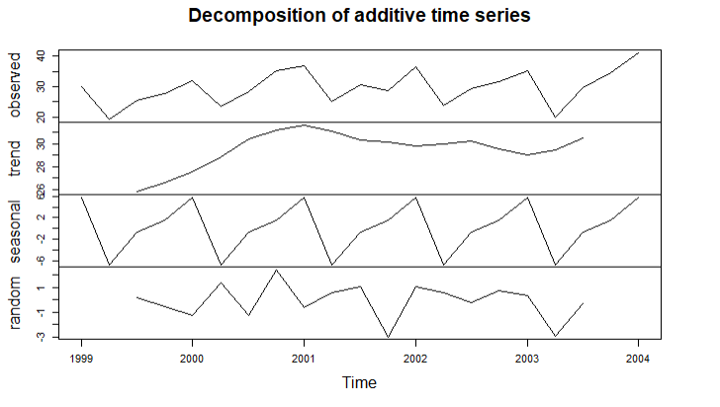
Activity Three: Holt-winters(Three parameters)
Comments source code
Looking at this plot we can notice that there are two important components here: A Seasonal Patterns and an upward trending pattern
Trend: the long-term trends in the data
Seasonal: the repeated seasonal signal adder
Random: the “left-over” components that aren’t expected from the seasonality or trend components
The scale of each section is very important. By analyzing each we will determine what is the predominant behavior. In this case Trend and Seasonality
When these conditions happen I think the multiplicative method will be a better option
***Taking a look at the scale of the Random o noise section is crucial, If the scale of this section is greater than the rest, then we are in the presence of something with high variability and random variation which is really hard to forecast and I don’t think HW will be suitable for it

Slide 15
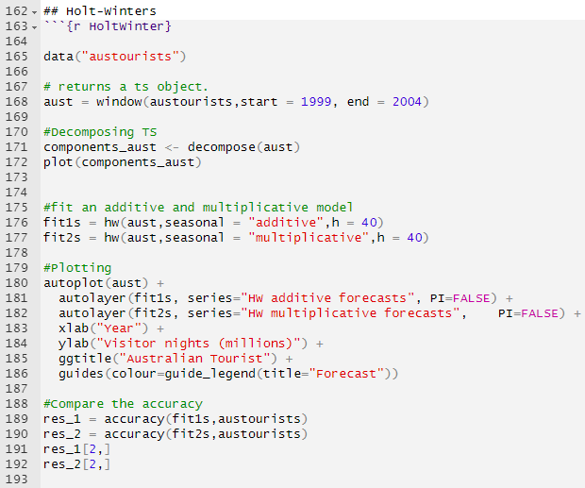
Activity Three: Holt-winters(Three parameters
Comments source code
Creating dataset
Decomposing initial time series
Fitting the models
Using autoplot to plotting
*Sometimes, I prefer autoplot to plot time series than the conventional function
Calculating errors

Slide 16
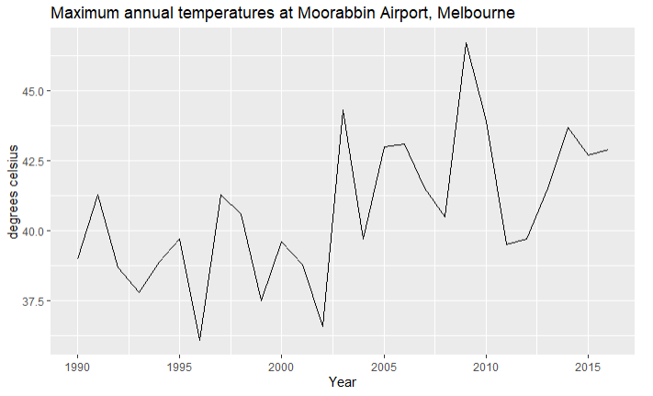
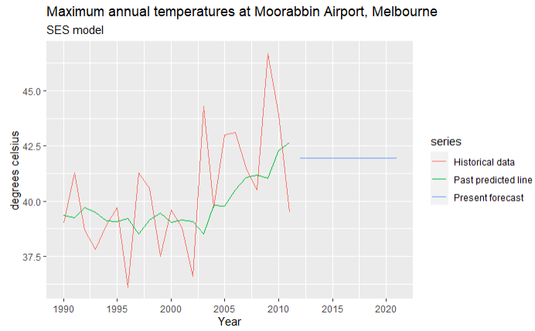
Activity Four: Full Analysis
Summary
Historical data
Single exponential smoothing model

Slide 17
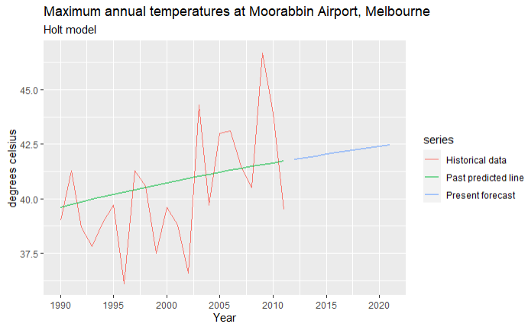
Activity Four: Full Analysis
Summary
Holt Model

Slide 18
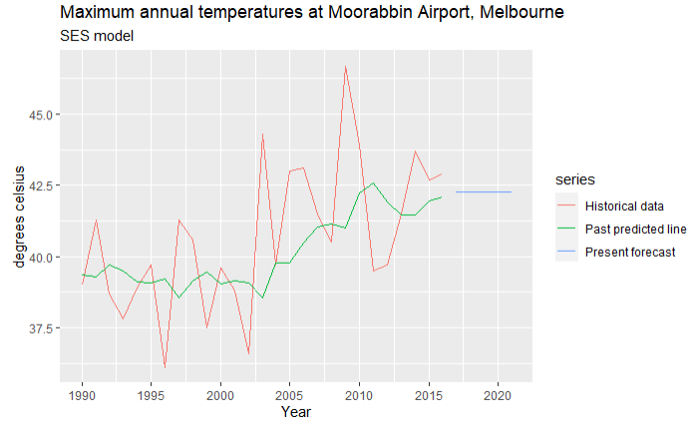
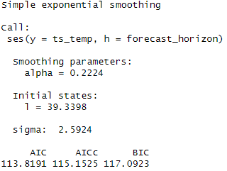

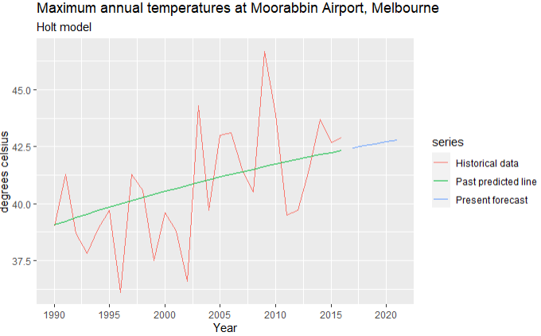
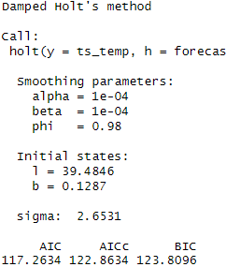

Activity Four: Full Analysis
Summary
Holt Model
Compare the AICc and BIC of the ses() and holt() models. Which model is better here?
SES is better because the AIC is lower
Calculate and compare the RMSE from the ses() and holt() models. Which one performs better with respect to this metric?
HOLT is better because the RMSE is lower for this model

Slide 19
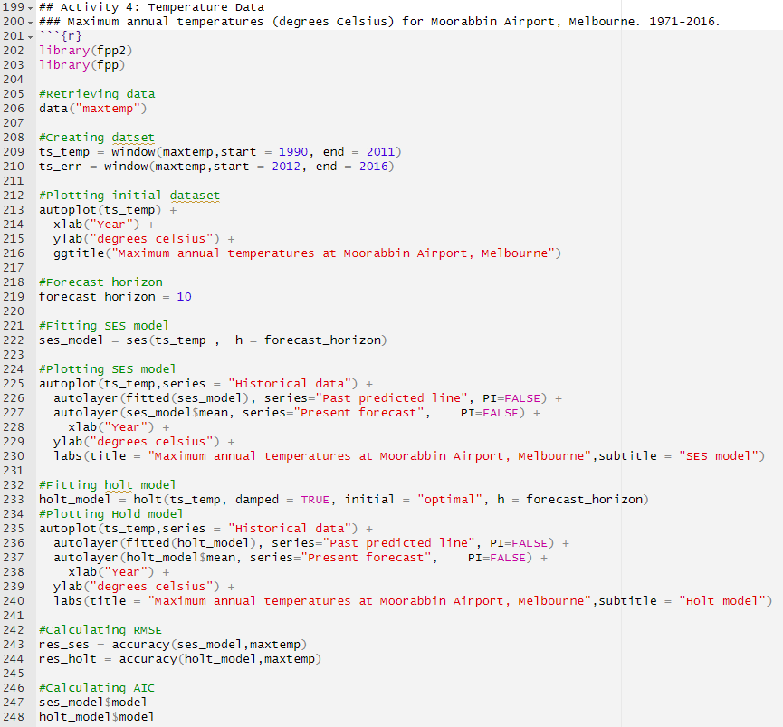
Activity Four: Full Analysis
Comments source code
Loading and creating dataset
Plotting historical data
Initializing SES model
Plotting SES model and Temp. history
Initializing Holt model, Plotting Holt model and Temp. history
Calculating accuracy measurements

Slide 20
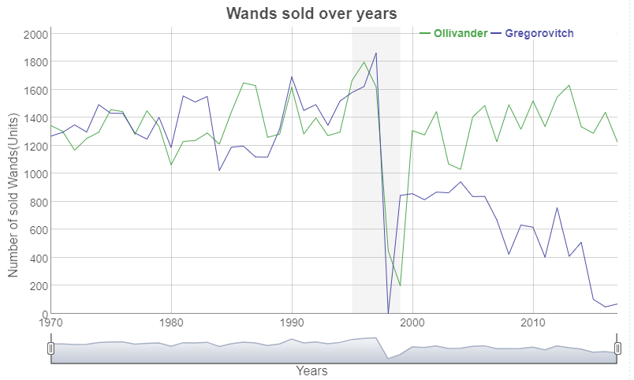
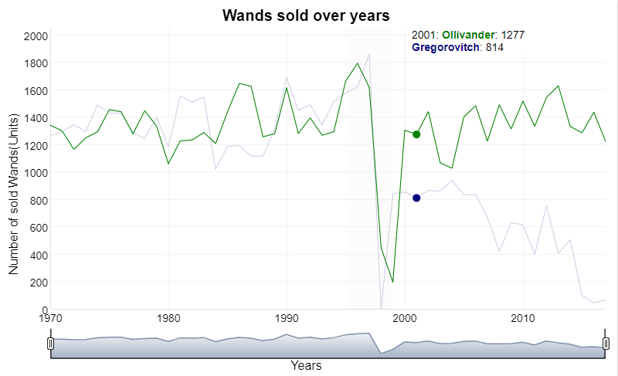
Bonus: The Wands Chooses the Wizard

Slide 21
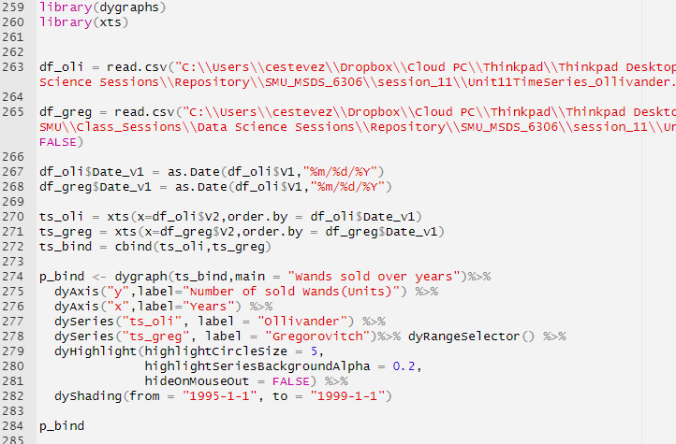
Bonus: The Wands Chooses the Wizard
Comments source code
Loading library
Loading csv files
Converting date from Character to Date
Converting to XTS Object and Binding both Time Series
Setting digraph options
Setting title
Adding labels to the axis
Assigning labels to the Time series
Highlighting period between 1995 and 1999
Adding Range selector
Plotting

Slide 22

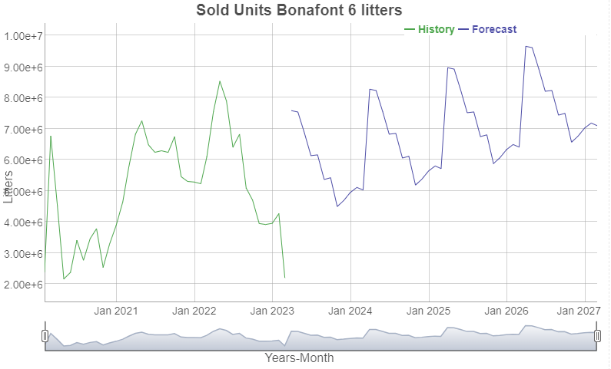
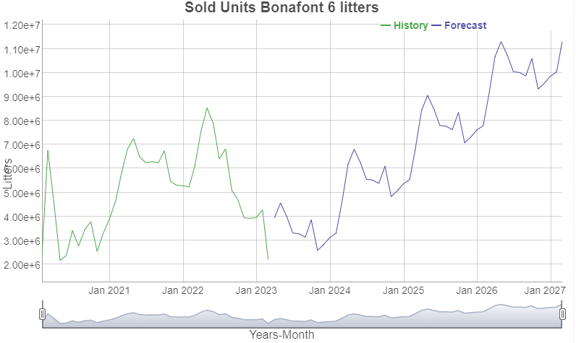
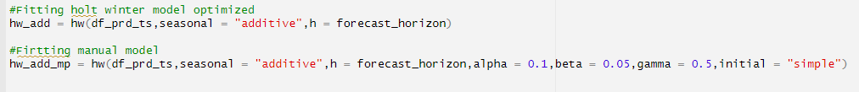
Questions
Questions
Look at this issue professor
Today I am using Holt Wynter in one of my projects and I wanted to compared the solution that I am currently using with HW R optimized model
In this example I downloaded the data from the ERP and I uploaded and transform it in R
When I used the optimized model look at forecast, not very good right?
However, when I used the parameters I have set in the solution I am using the results are really good. Almost very similar to the one I am using for this company
It seems that the optimized model is not the best option in every scenario and sometimes what I did about setting the parameters manually is the best alternative. What do you think?
Parameters assigned manually: alpha = 0.1,beta = 0.05,gamma = 0.5
Optimized

Slide 23
Takeaway
Great lesson, I learned a lot, I did not know how to manage TS in R and now I can even create real examples in R

